Slide 1
Multimedia and authoring tools

Slide 2
introduction
Multimedia is any combination of text, graphic art, sound, animation and video delivered to the user by means of a computer other electronic media. An effective multimedia presentation not only presents information in a dazzling manner, but also more effective in holding attention and interest of the viewer and it improves information retention. This makes multimedia a very effective communication tool in variety of areas such as, in business as a presentation and sale tool, in home for entertainment and games, in education for teaching and training, in public for information and advertisement, etc.

Slide 3
Hardware and software
As multimedia computer systems handle digitized audio and video, they need to be powerful systems and will commonly be using a fast processor. A multimedia computer system will consist of following components:
Powerful high speed central processor with clock speed of over 200 Mhz.
Random access memory 32 Mbytes or more
Hard disk drive 2Gbytes or more.
Input through floppy disk drive or CD-ROM.
Display of visual output on SVGA/XSVGA quality monitors, minimum a 14" color monitor with 256 colors at 640*480 resolution.
Graphics accelerator card to enhance the imaging capacity of the computer.
Audio input and output devices, e.g. microphones and loudspeakers with appropriate sound card.

Slide 4
Peripheral cards
All most all multimedia elements such as sound, movies, etc. Consist of analog signals analog signals are continuously varying signal that propagate in the form of a wave. But fortunately the computers understands only digital signals, i.e. signals represented by zero and ones. Most of the multimedia hardware needs its own set of hardware/software interfaces are called add-on cards or peripheral cards. Basically these cards are printed circuit boards with the relevant integrate circuits and input or output sockets that fits into the slots inside the computer. Some types of add-on cards that are used by multimedia computers are:
Display adapter card for color display: A Display is an expansion board that plugs into a personal computer to give it display capabilities.
Sound card for audio: sound card manage almost all possible kind of audio. They are basically meant for digital audio recordings, amplification, playback and a number of other fundamental audio function.
MIDI interface card to interact with musical instruments: MIDI cards are special purpose audio cards exclusively meant for recording music directly form electronic instruments such as electronic keyboard.

Slide 5
1. Minimum resolution requirement
Monitor size | Resolution
14" or 15" | 640 x 480 or 800 x 600
17" | 800 x 600 or 1024 x 768
21" | 1024 x 768 or 1600 x 1200
2. Numbers of colors
VRAM | Resolution | Color bits/pixel | Colors Available
0.5MB | 640 x 480 | 8 | 256 colors
1MB | 640 x 480 | 24 | More than 16 million
1MB | 800 x 600 | 16 | 32,768 colors
2MB | 1024 x 768 | 16 | 32,768 colors
2MB | 1600 x 1200 | 8 | 256 colors

Slide 6
Multimedia storage system
Compact disc-read only memory(CD-ROM): The main attraction of it is its large storage capacity; but it still holds only 30 minutes of moving image.
Compact disc-recordable(CD-R): It is an excellent method for disturbing multimedia project. But there are cost is more than CD-ROM.
Compact disc-interactive(CD-I): It is a specialized compact disk player with a built-in processor connected to a television set.
Digital video interactive(DVI): It uses compression techniques to store full-motion video on a standard CD-ROM.
Digital versatile disc(DVD):it is a new optical technology capable not only of 4.7 gigabytes storage capacity but also of full-motion video and high-quality audio in surround sound.

Slide 7
Image formats
Graphic file formats differ in the way they represent image data(as pixel or vector) and in compression technique. Many different image file formats have been developed over years for specific application and hardware. Most application support a large number of commonly used file formats. Most image formats incorporate some variation of a compression technique due to large storage size of image files. Compression techniques can be classified into either lossless or lossy . Lossy schemes ignore picture information the viewer may not miss, during compression. The lost information cannot be retrieved even after decompression and hence image quality decreases. Lossless schemes on the other hard preserve the original data precisely on compression. The user needs to know the pros and cons of the various formats so that he can decide which format is best suited for his needs.

Slide 8
Tagged image file format (TIff)
Developed by the Aldus crop. In 1980's and later supported by the Microsoft.
Stores many different type of images (e.g. monochrome, grayscale, 8-bit & 24-bit RGB, etc).
TIFF is a lossless format.
The TIFF format is easily exchanged between Macintosh and windows machines.
It does not provide any major advantage over JPEG and is not as user-controllable. It appears to be declining in popularity.

Slide 9
Windows bitmap (bmp)
A system standard graphics file format for Microsoft windows.
Used in PC paintbrush and other programs.
It is capable of storing either 2 (black and white), 16, 256 or 16.7 million colors.
Most Windows Bitmap files are not compressed.
The default file extension for Windows Bitmap files is ".BMP". Occasionally you may see Bitmap file with the extension ".DIB" which stands for 'Devices-independence bitmaps'.

Slide 10
Joint photographic expert group
A standard for photographic image compression created by the JPEG.
Takes the advantage of limitations in the human vision system to archive high rates of compression. The human eye is relatively insensitive to tonal differences in the brightest areas.
Lossy compression that allow user to set the desired level of quality.
Uses 16-bit format and is capable of displaying millions of colors.
The default file expansion for JPEG files is " .JPG".

Slide 11
Graphic interchange format
Developed by CompuServe INC. For use on their on-line services.
Limited to only 8-bit color images, suitable for distinctive colors
GIF files have one of the best compression capabilities and offer a efficient way to store large amount of images.
GIFs can be animated. Most animated banner apps are GIFs.
The default file extension for graphics interchange Format files is ".GIF".

Slide 12
Thank you made by: pulkit sharma xii-d 11413

Slide 13

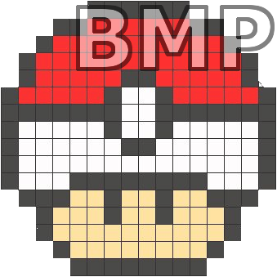
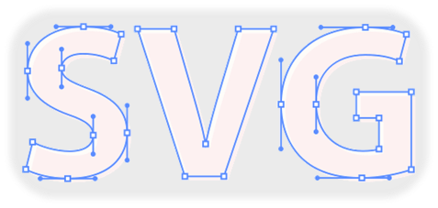
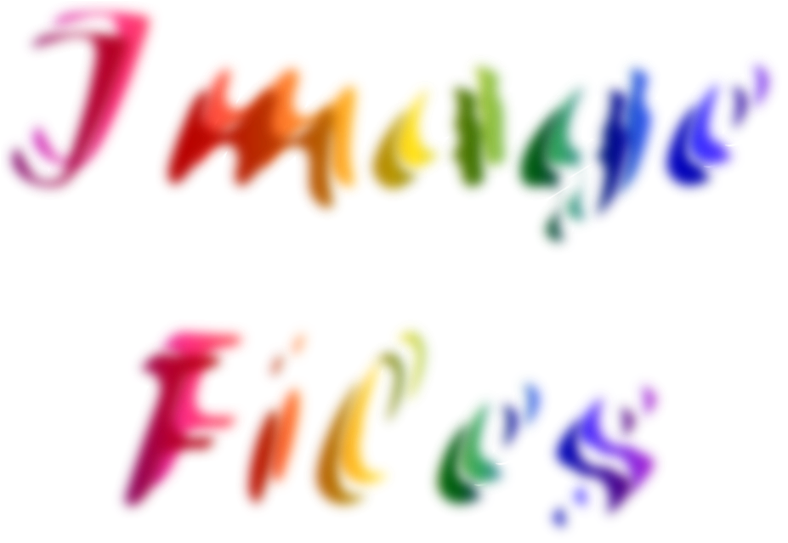



Slide 14
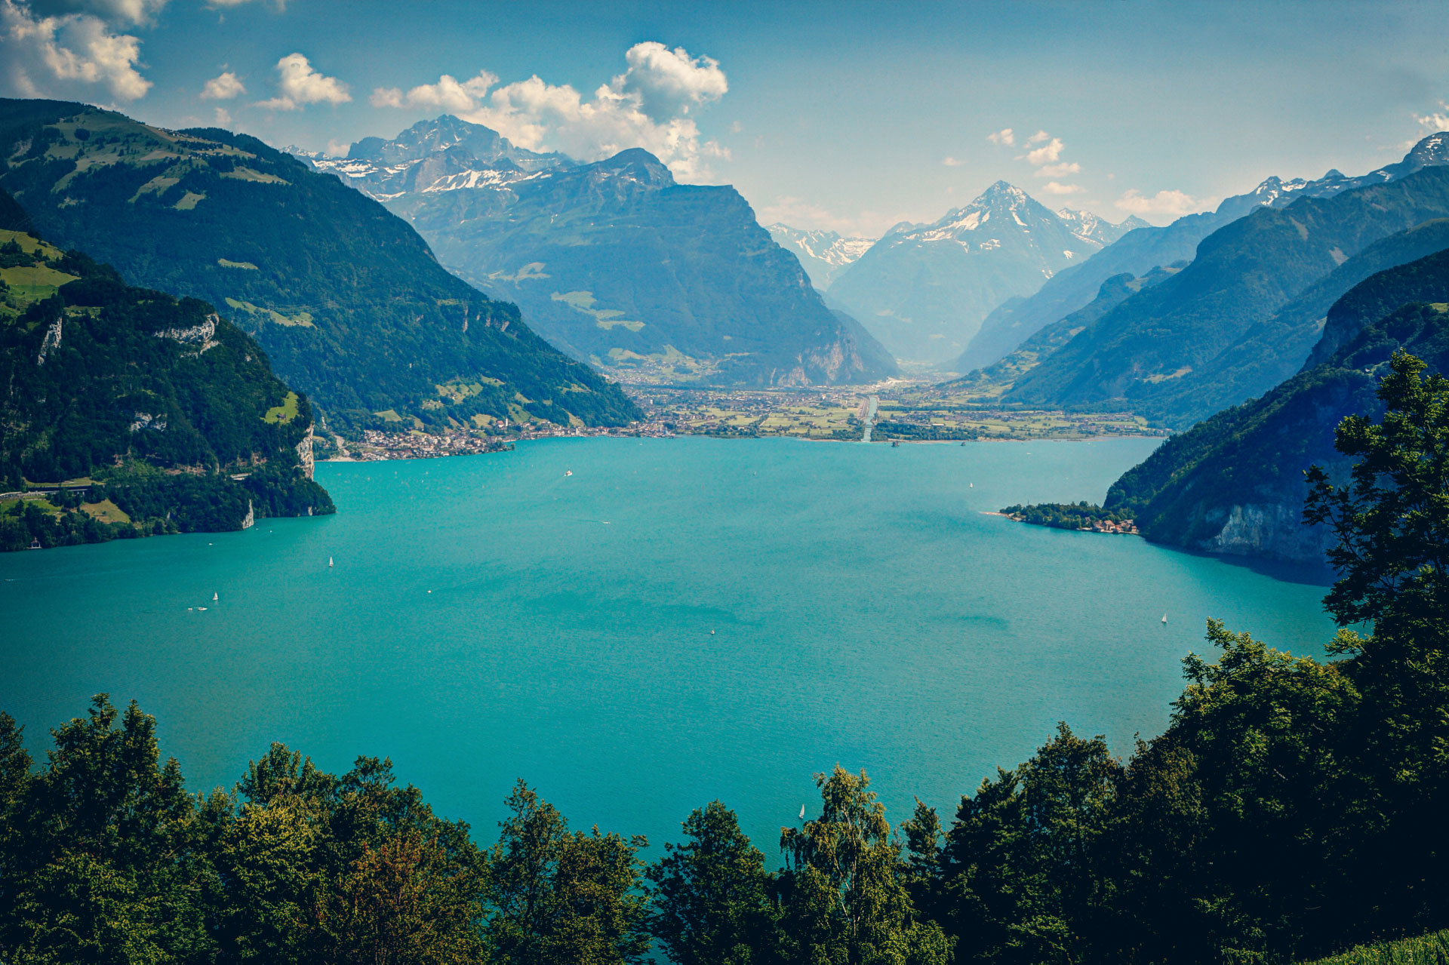
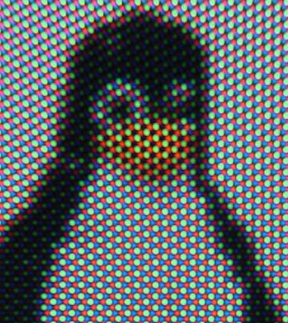
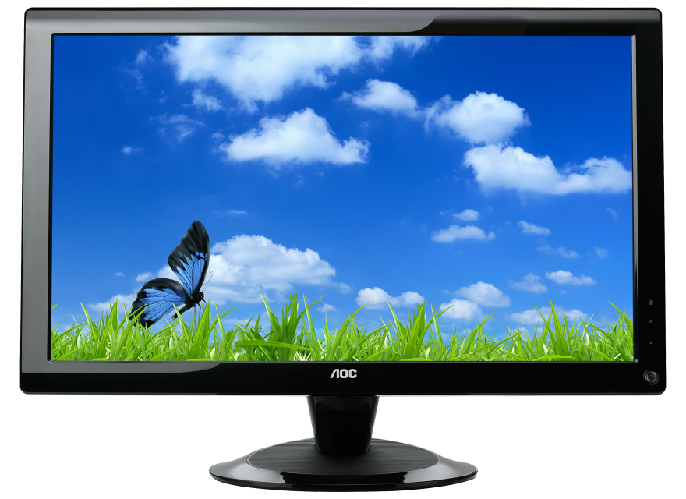

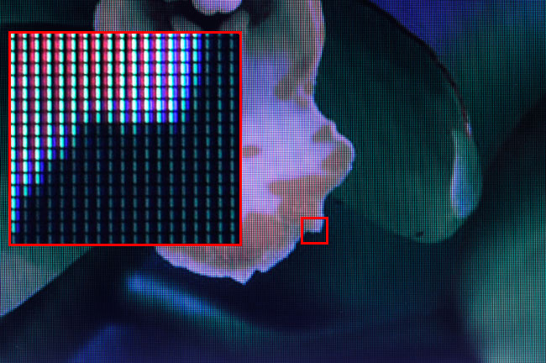
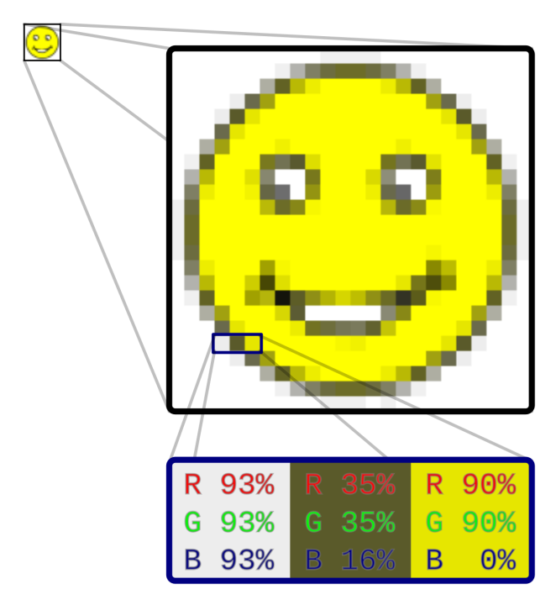
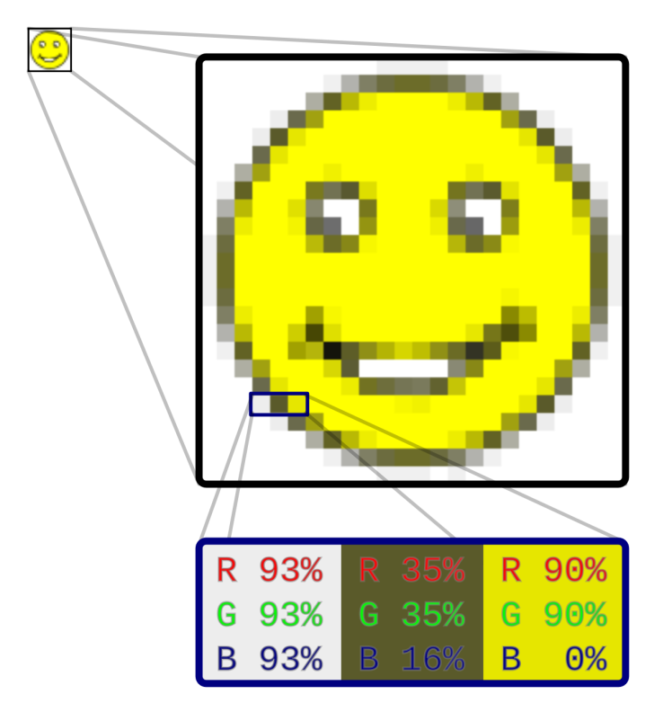
Every image is made of countless tiny square dots called pixels. In most images, pixel colors are determined by Red, Green & Blue (RGB) color components.

Slide 15
Basic File Structure of Typical Images
File Header
1 | 2 | 3 | ST | 4 | 5 | 6 | ST | 7 | 8 | 9 | ST
1 | 2 | 3
4 | 5 | 6
7 | 8 | 9
Red | Green | Blue | Alpha
8 bytes | 8 bytes | 8 bytes | 8 bytes
Image
RGB (24-bit) / RGBA (32-bit)

Slide 18

IMAGE EDITING TOOLS

Slide 19
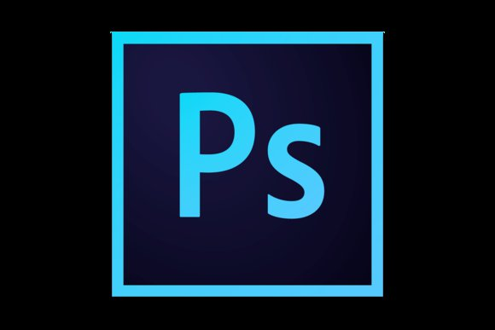

Slide 20
PHOTOSHOP
As a picture is better than a thousand words then imagine what would a perfect picture would do.
To achieve this perfection Photoshop which is an industrial standard software developed by Adobe systems is used.
It is an image editing tool it is used to prepare images for web pages, to correct and retouch photograph
Having do much competition in the new era Photoshop still stands put as a winner with having some amazing features

Slide 21
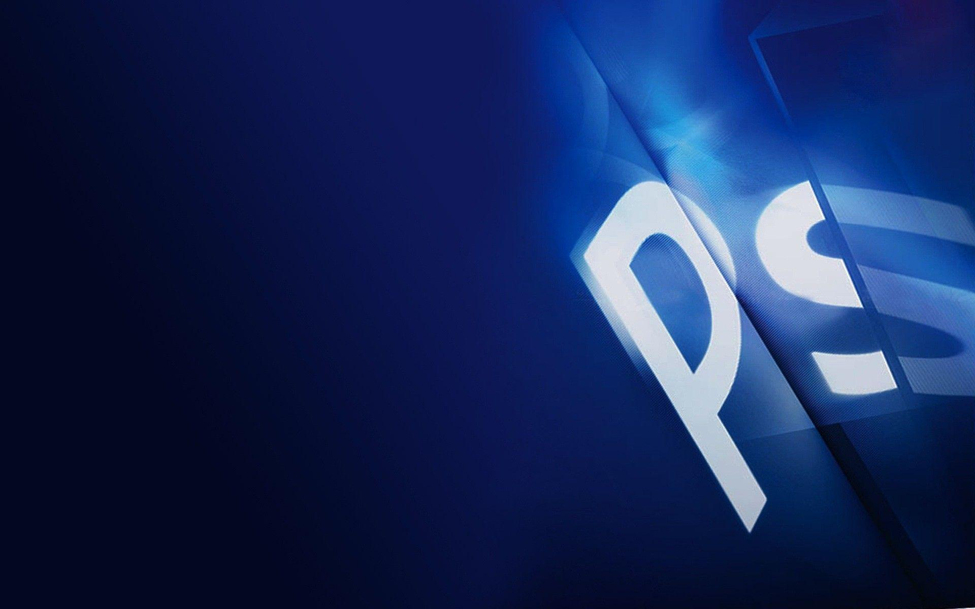
THE TOOLBOX
All the tools are for :-
Selecting
Painting
Drawing
Editing
Viewing images
Cropping
Adding effects

Slide 22
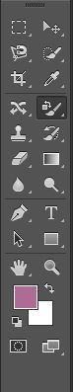
Selection Tool
Move Tool
Lasso Tool
Magic Wand Tool
Crop Tool
Healing Brush Tool
Brush Tool
Eraser Tool
Gradient Tool
Blur Tool
Text Tool
Zoom Tool
Foreground color
Background color

Slide 23

COLOR MODES
Determines color model as per user requirement
HSB(Hue , Saturation, Brightness)
RGB(Red, Green, Blue)
CMYK(Cyan , Magenta, Yellow, Black)

Slide 24
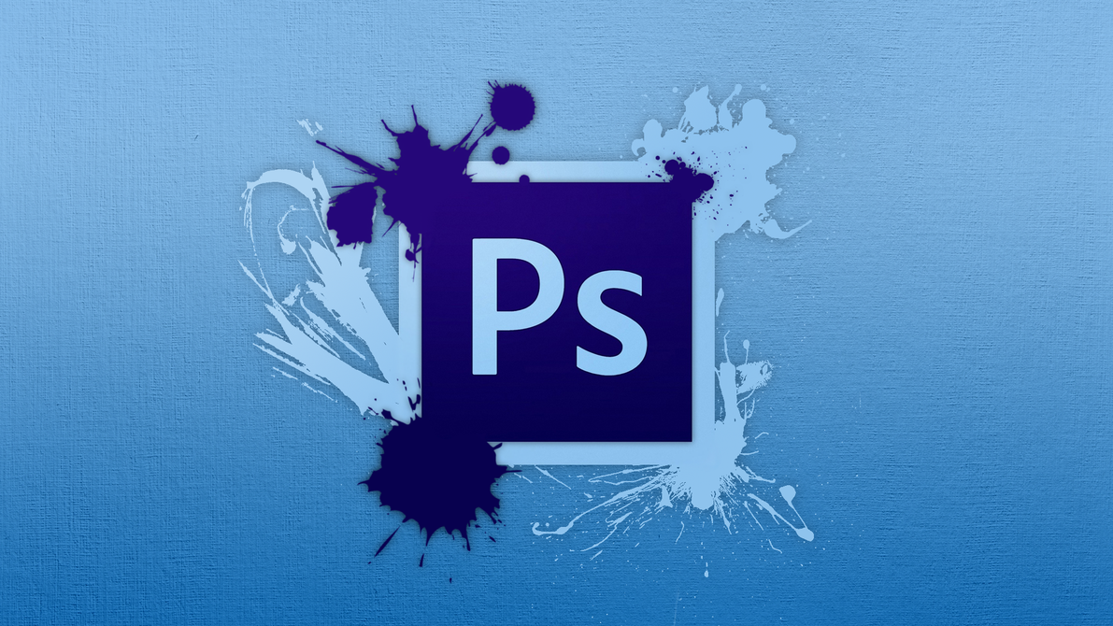
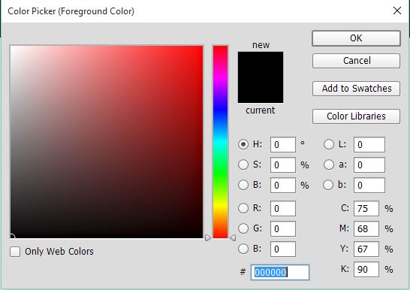
COLOR PICKER TOOL
Opens when foreground color is clicked two times
Colors can be choosaed by using different color modes like RGB ,HSB
Used to define color in the color palette

Slide 25
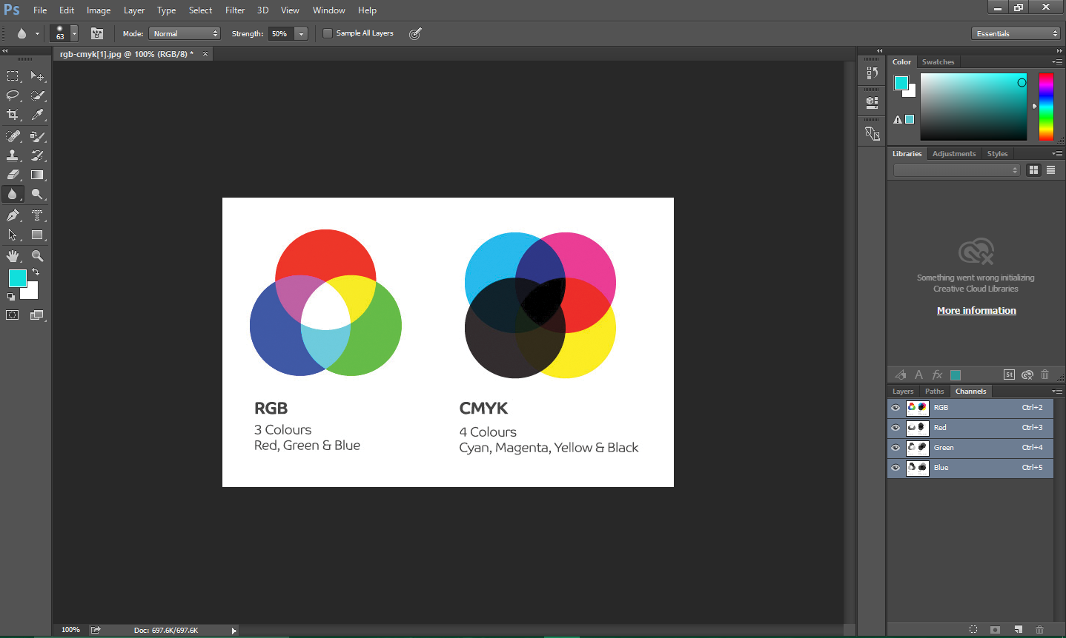
USING CHANNELS

Slide 26
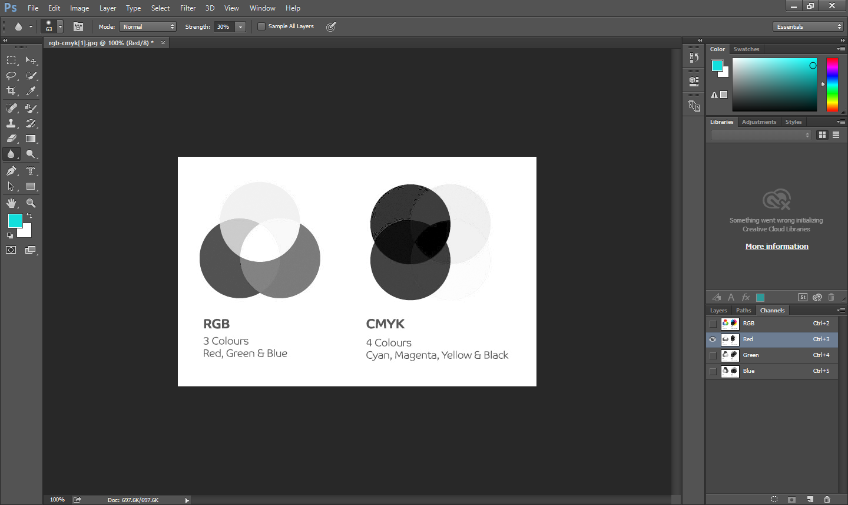
HERE WHITE COLOR INDICATES THE RED COLOR

Slide 27
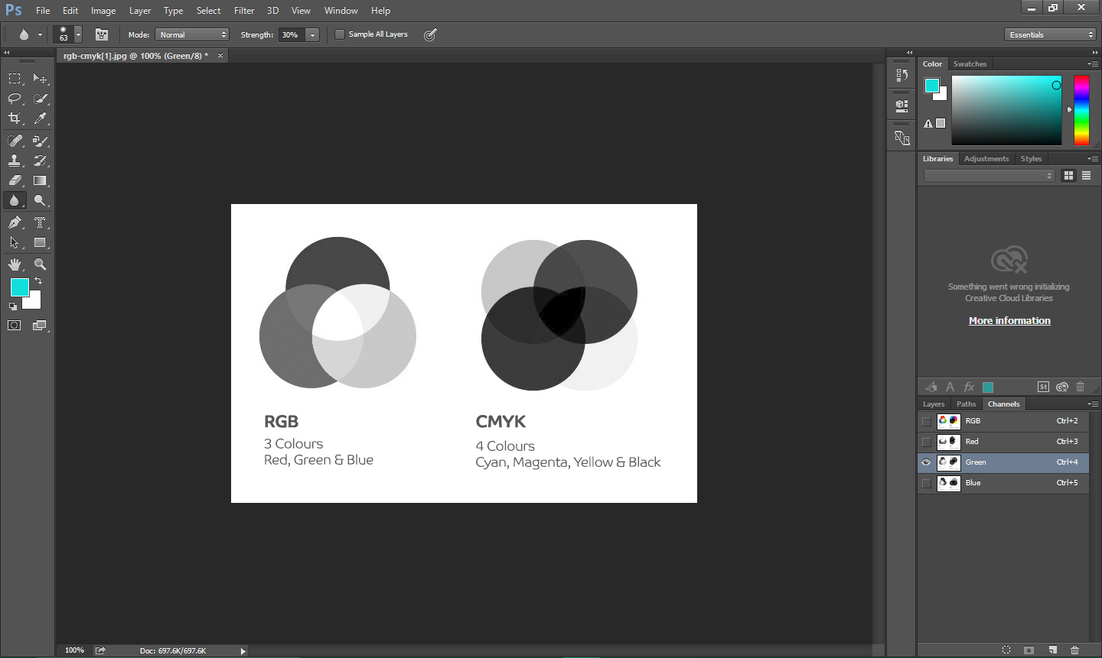
HERE WHITE COLOR INDICATES THE GREEN COLOR

Slide 28
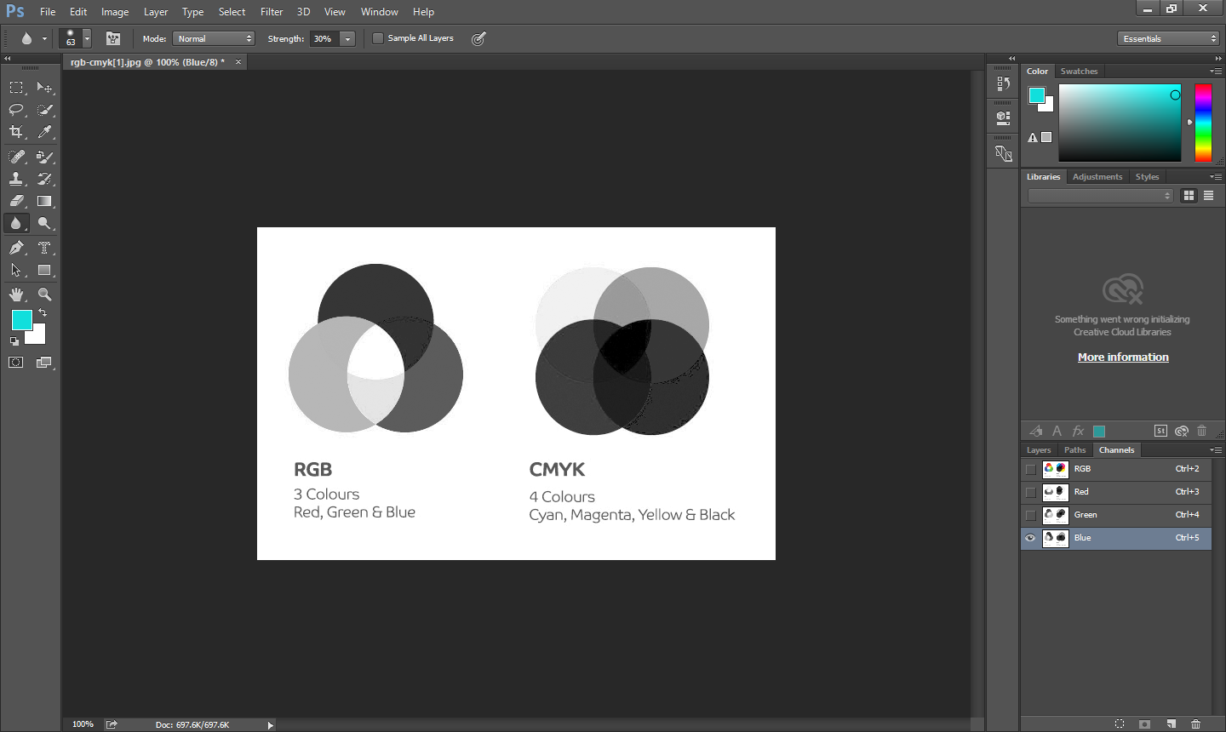
HERE WHITE COLOR INDICATES THE BLUE COLOR

Slide 29
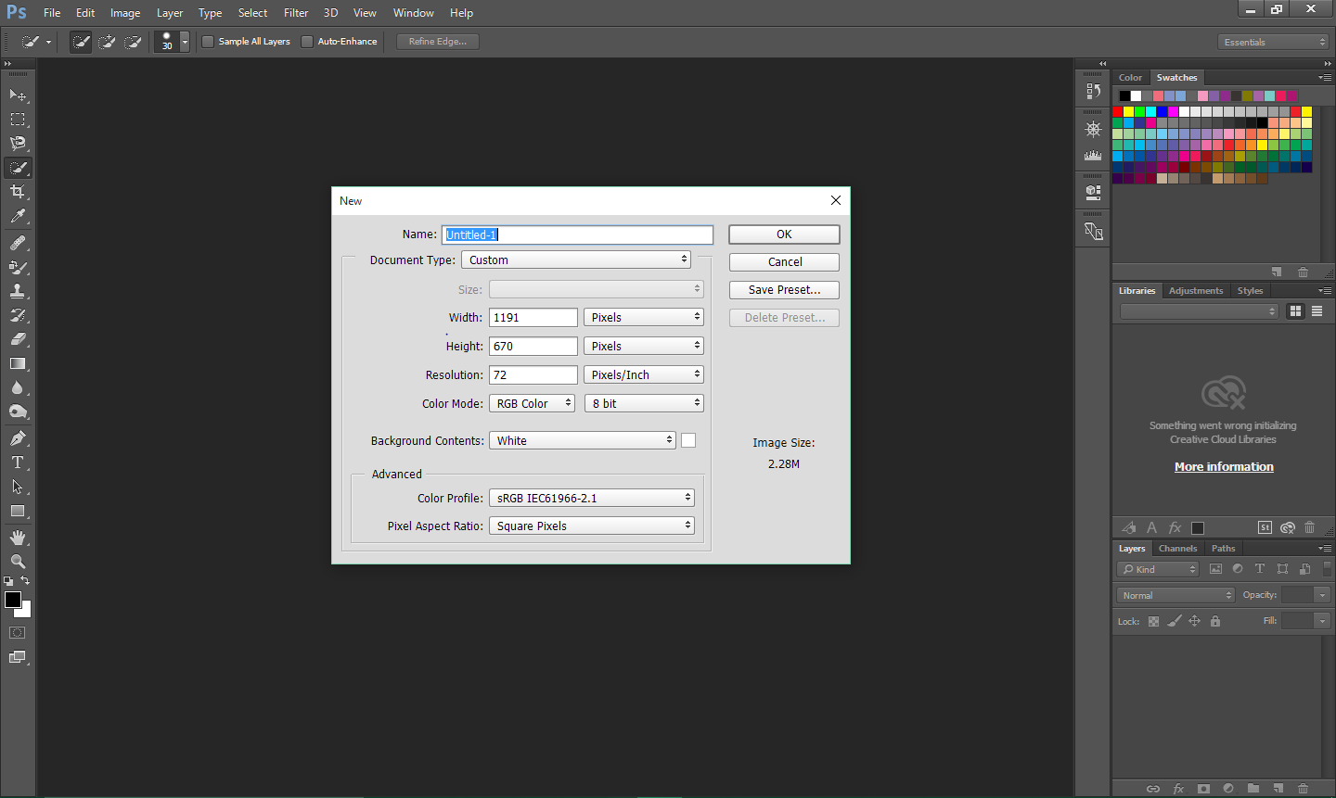
SWATCHES PALETTE
LIKE BOX OF COLOURS
SIMPLY CLICK FOR FOREGROUND COLOUR
CTRL+CLICK FOR BG COLOR
THIS IS HOW PHOTOSHOP WORKSPACE LOOKS LIKE

Slide 30
CREATING LAYERS
Layers are transparent layer sheet which helps in editing the image without disturbing the other.
Layers are used to join images

Slide 31
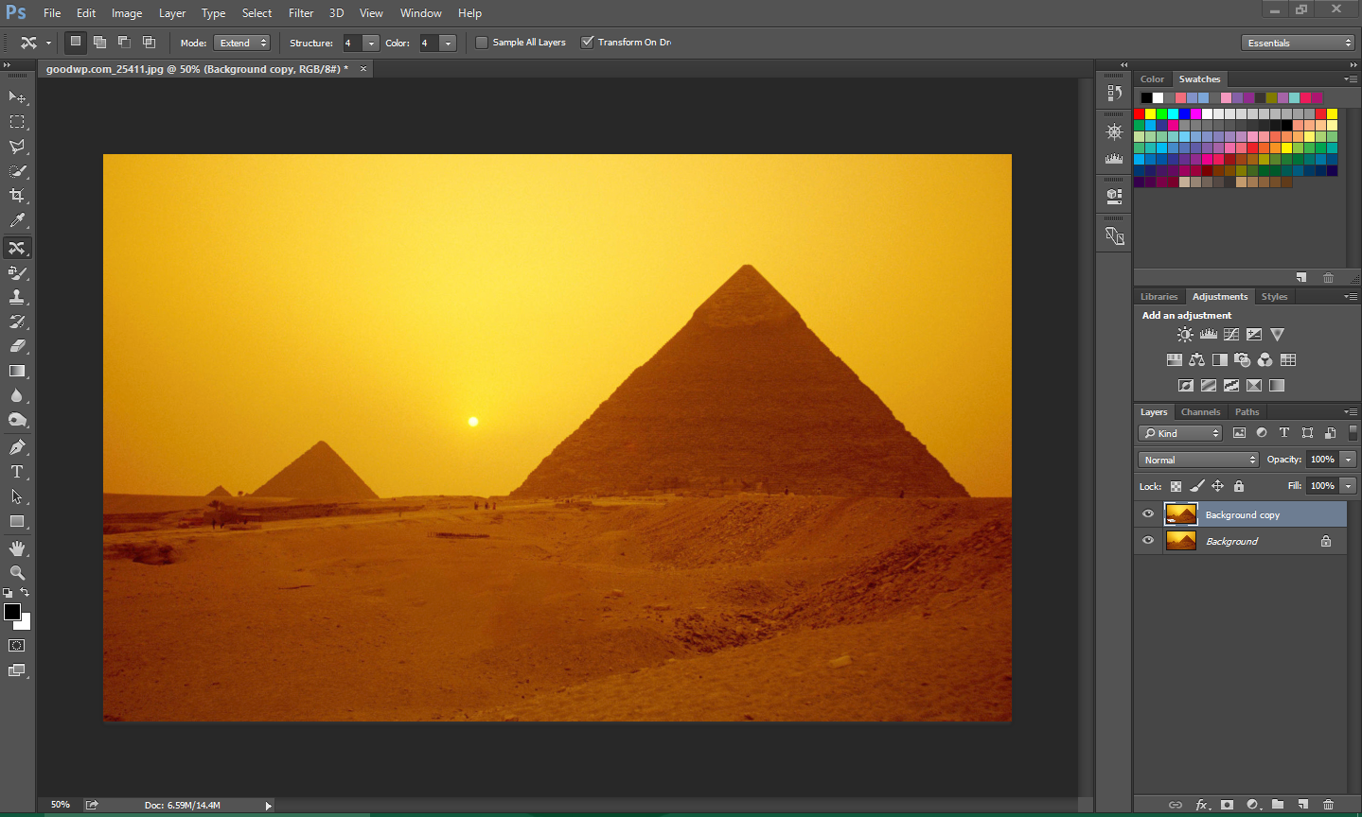
RIGHT CLICK ON IMAGE AND SELECT DUPLICATE LAYER
LAYERS CAN BE CREATED BY
CLICKING THIS BUTTON.

Slide 32
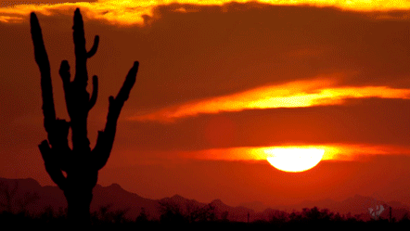
THIS IS A IMAGE IN GIF FORMAT
LETS
CHECK IT IN PHOTOSHOP!!

Slide 33
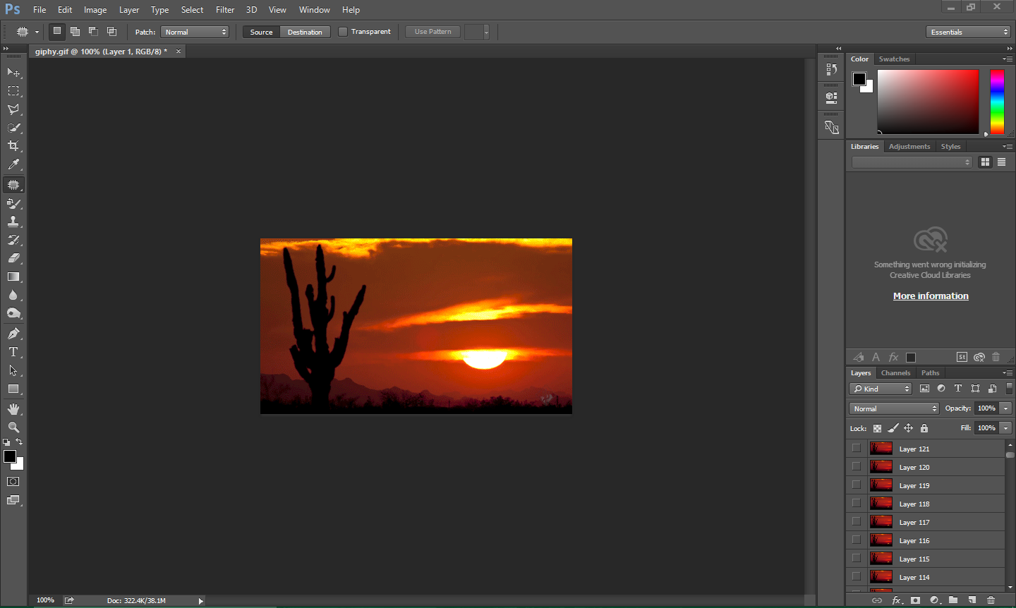
A TOTAL OF 121 LAYERS WITH EACH LAYER HAVING SIMILAR IMAGE BUT IN DIFERRENT POSITION.
THUS SHOWING HIDDEN TRUTH BEHIND GIF

Slide 34
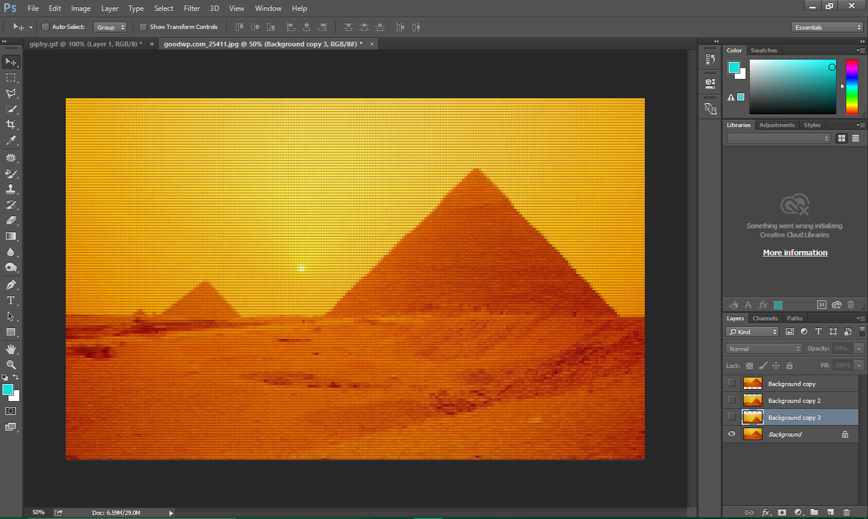
THREE DUPLICATE LAYERS ARE CREATED AND THEIR POSITION ARE CHANGED USING MOVE TOOL
THIS EYE ICON IS USED FOR AS A VISIBILITY OPTION

Slide 35
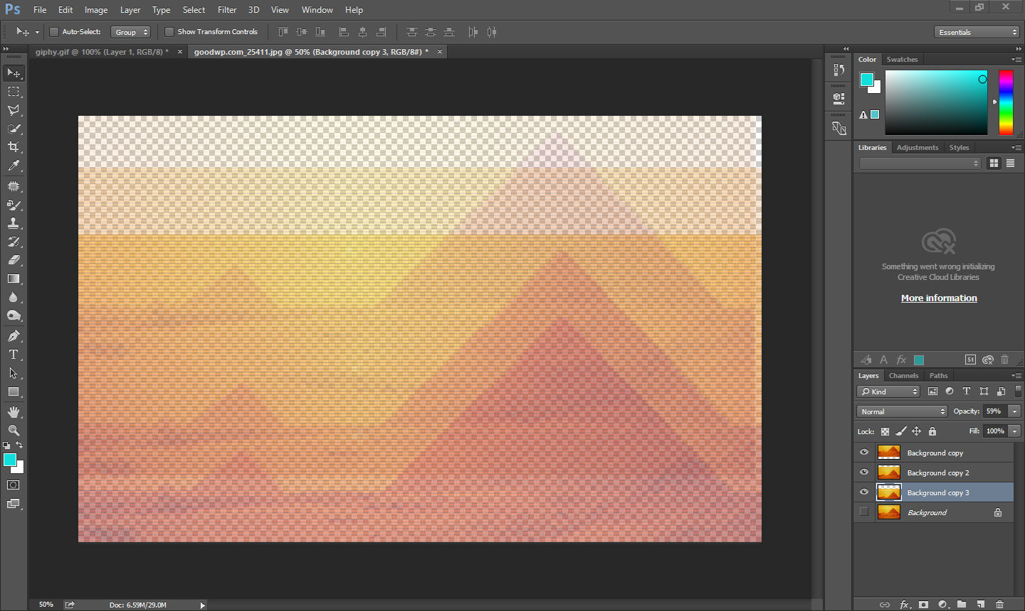
SEE AFTER CHANGING OPACITY
WHAT HAPPENS.
THEY
ARE
TURNED VISIBLE

Slide 36
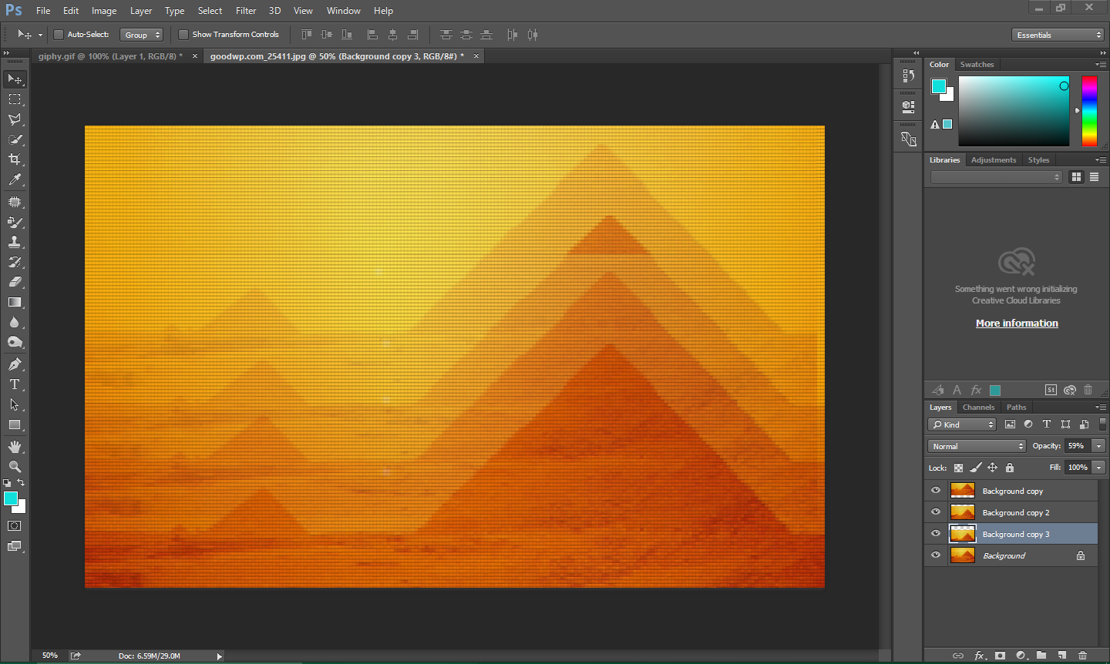
CREATING A MERGED IMAGE EFFECT
WHEN ALL
ARE
TURNED VISIBLE

Slide 37
WORKING WITH THE EDGES OF SELECTION
ANTI-ALIASING
It smoothens the jagged or ragged edges.
Basically creates an illusion by covering the edge pixels.
No Data Of Image Is Lost.
FEATHERING
Blurs edges of the image and joining pixels btw the selection and surrounding.
Some Data Of Image Is Lost

Slide 38
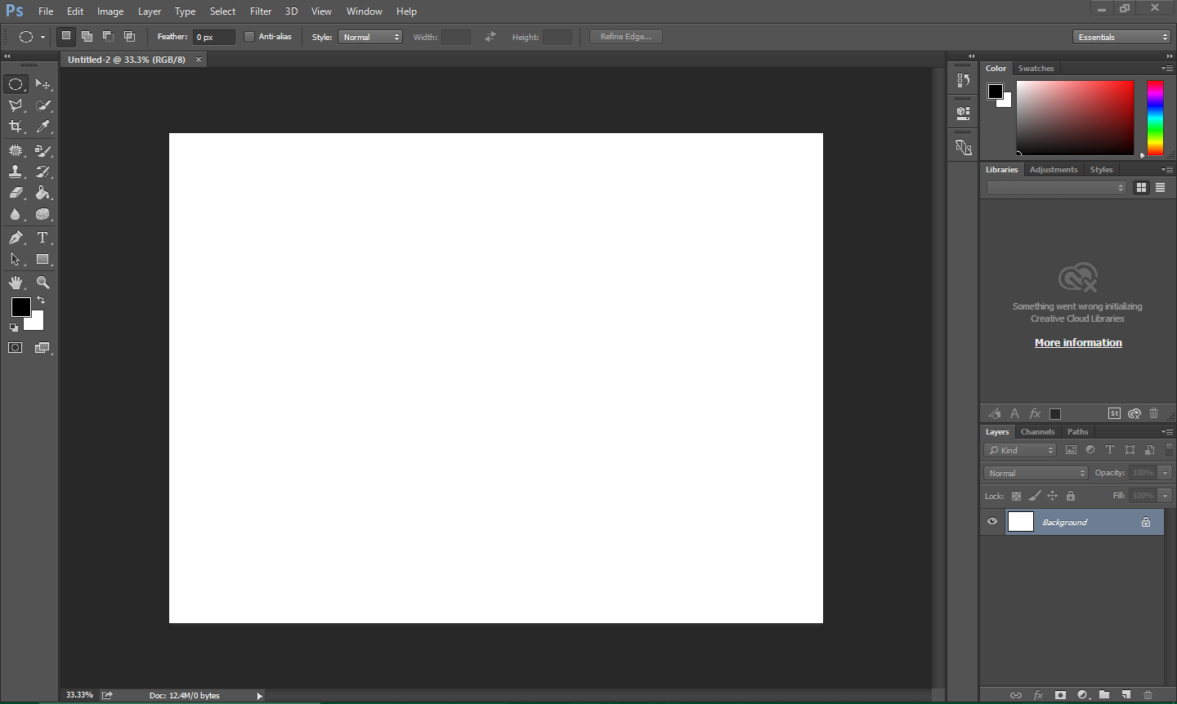
Select the Elliptical Marquee Tool
Make sure this checkbox is off.

Slide 39
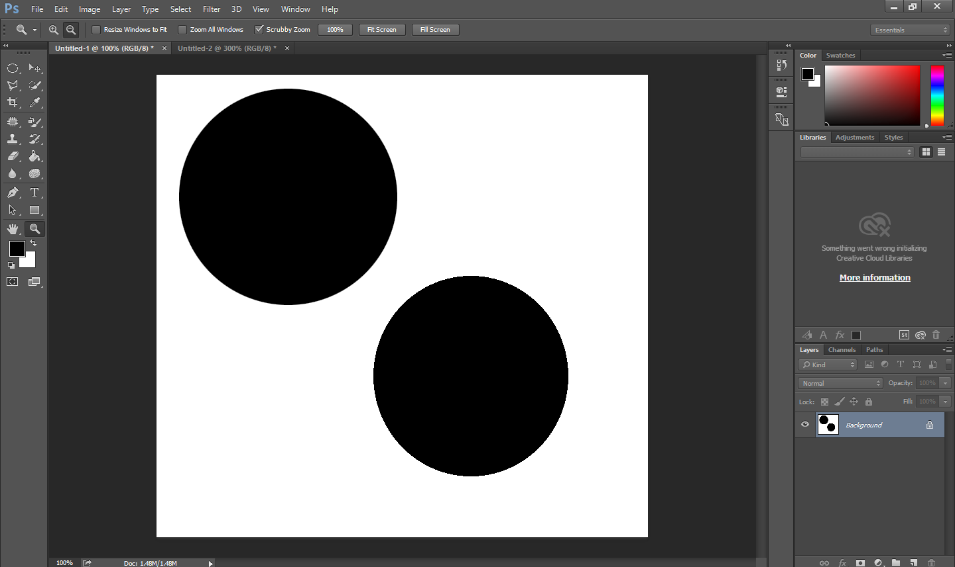
This is a ellipse which is
Anti-Aliased
This is a ellipse which is
NOT Anti-Aliased

Slide 40
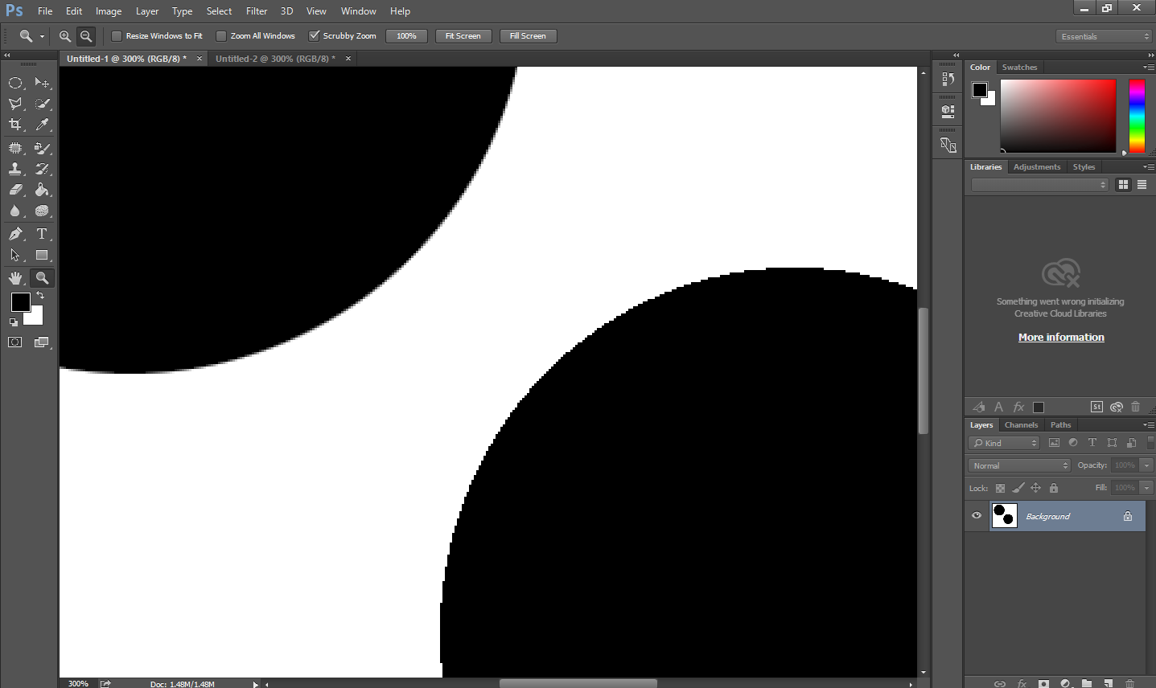
WHEN ZOOMED
See the Edges

Slide 41
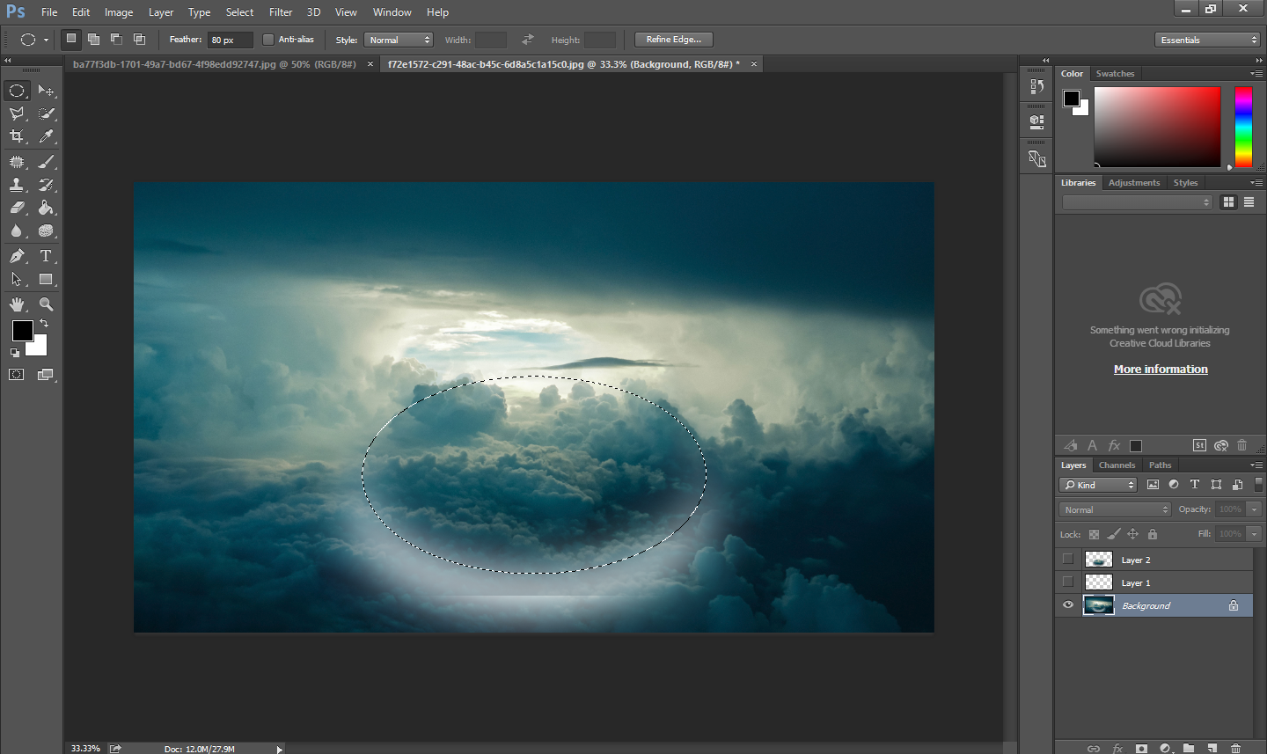
Select the Elliptical Marquee Tool
ENTER FEATHERING RANGE FROM 1-250

Slide 42
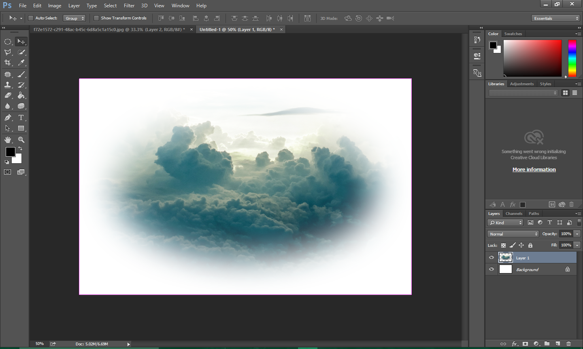
SEE THE EDGES

Slide 43
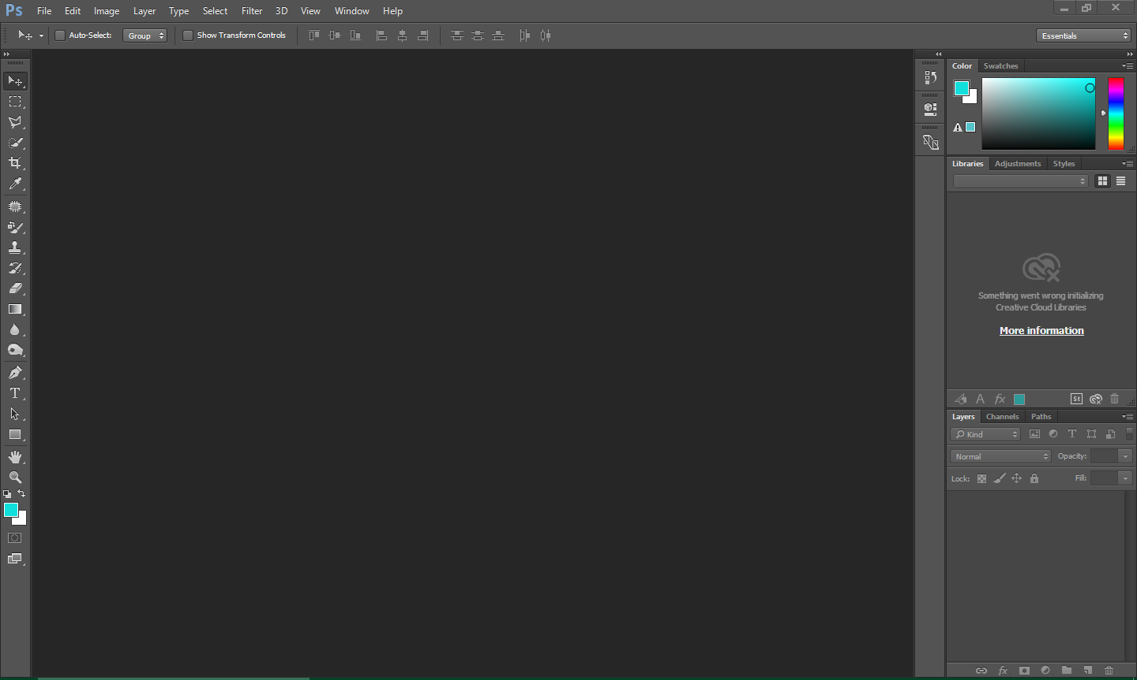
PHOTOSHOP CAN ONLY PROVIDE YOU WITH MULTIPLE WAYS TO ENHANCE THE PICTURE ITS UPTO THE PERSON HOW TO CREATIVIZE

Slide 44
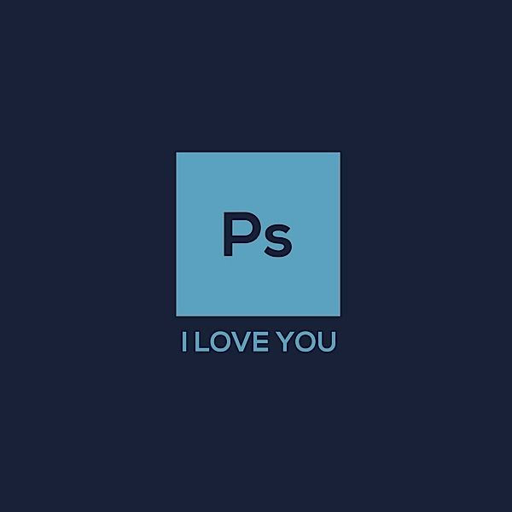

Slide 45
THANK YOU

